Slide 1
Project meeting
2019.1.2

Slide 2
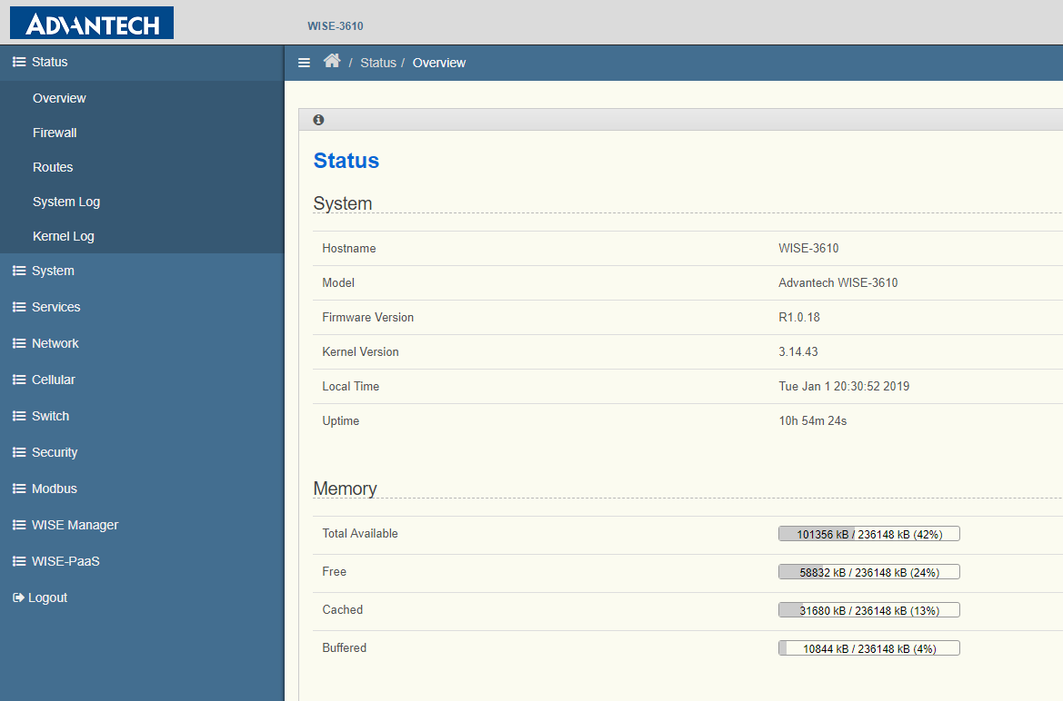
Setting of ADVANTECH LoRa Gateway

Slide 3

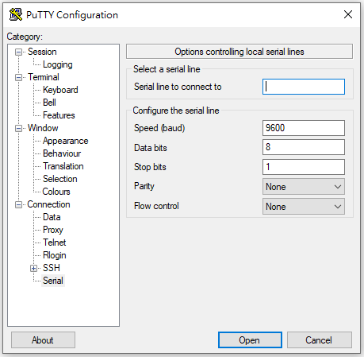
Transmission of LoRa IoT Node

Slide 4
Type of data format
Simulation of Measuring
Data Name(ID)
Getting time(yy/mm/dd/hr:min:sec:00:00)
voltage value (V)
current value (A)
consumed power (kWh)
frequency (Hz)
power factor (W)
Raw
Value
String
Boolean
GPS

Slide 5
Taiwan (920 - 925 MHz): AS923 Default Settings
The parameters are recommended values of band.
RECEIVE_DELAY1 1 s
RECEIVE_DELAY2 2 s
JOIN_ACCEPT_DELAY1 5 s
JOIN_ACCEPT_DELAY2 6 s
MAX_FCNT_GAP 16384
ADR_ACK_LIMIT 64
ADR_ACK_DELAY 32
ACK_TIMEOUT 2 +/- 1 s

Slide 6
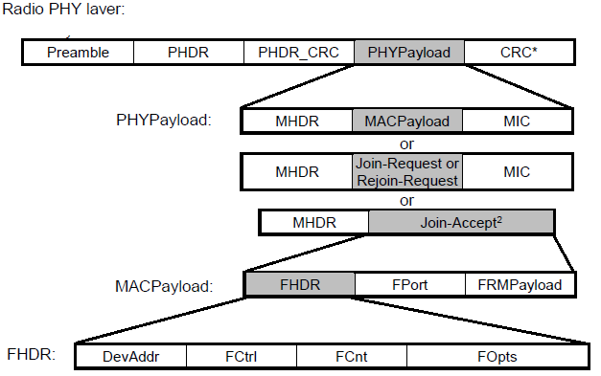
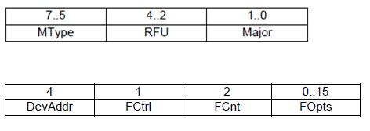
MAC Message Formats
1B
7-22B
4B
Bits
MHDR
7-22B
0-1B
0-21B
Bytes
FHDR

